Slide 1
Challenge 3.1​
By: Tan Jia Shun (Alan)
S10198161

Slide 2
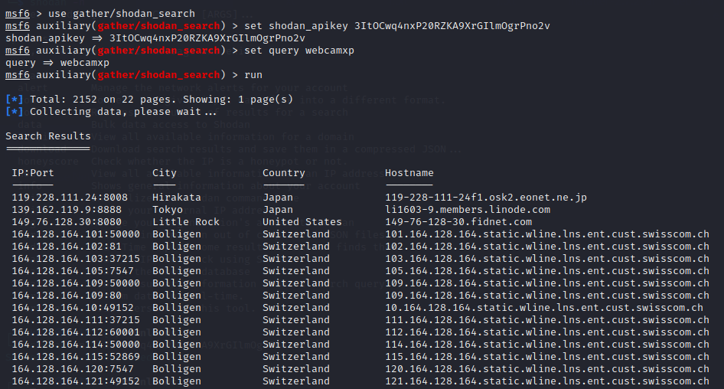
Set API and set query to webcamxp

Slide 3
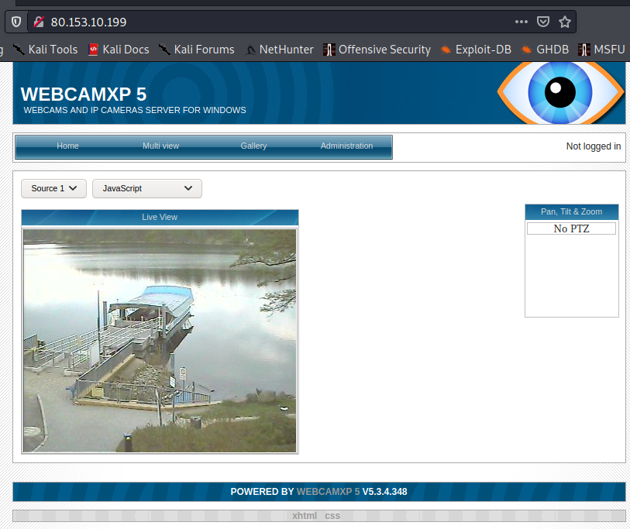
Pick an IP from the result

